Slide 1
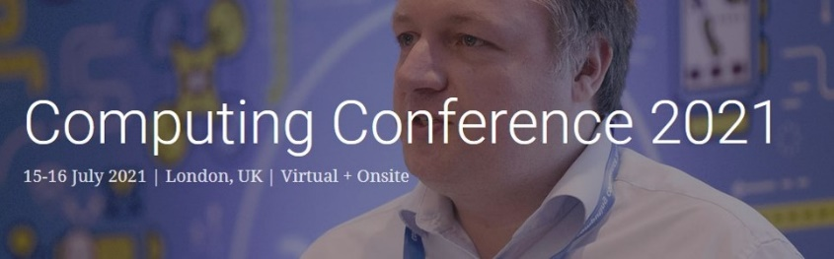
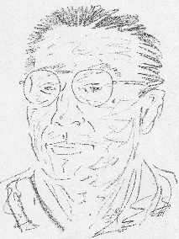
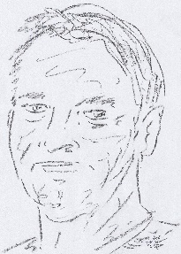
Slide 1 of 33
Cell Assembly-based Task Analysis (CAbTA)
NEXT
Dan Diaper
DDD SYSTEMS
Chris Huyck
Middlesex University
Cell Assembly-based Task Analysis (CAbTA)
Dan Diaper & Chris Huyck
DDD SYSTEMS Middlesex University
SOUND TEST
Abstract. Based on an Artificial Neural Network model, Cell Assembly-based Task Analysis is a new method that outputs a task performance model composed of integrated mind-brain Cell Assemblies, which are currently believed to be the most plausible, general organisation of the brain and how it supports mental operations. A simplified model of Cell Assemblies and their cognitive architecture is described and then used in the method. A brief sub-task is analysed. The method’s utility to research in Artificial Intelligence, neuroscience and cognitive psychology is discussed and the possibility of a General Theory suggested.

Slide 2

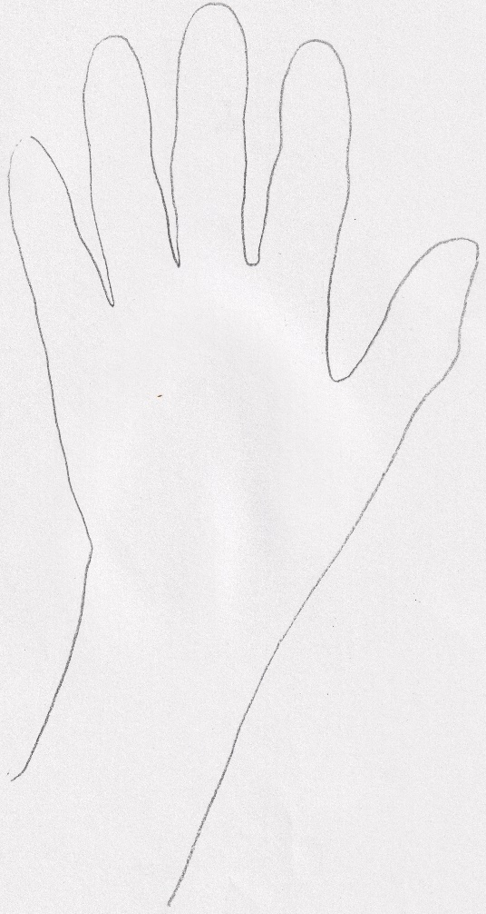
Slide 2 of 33
Cell Assembly-based Task Analysis (CAbTA)
NEXT
Dan Diaper
DDD SYSTEMS
Chris Huyck
Middlesex University
SOUND TEST
END SHOW
for
SOUND TEST
REPEAT
… old joke …
IF
you can’t
hear me
wave your
hand.

Slide 3

Slide 3 of 33
Cell Assembly-based Task Analysis (CAbTA)
Dan Diaper
DDD SYSTEMS
Chris Huyck
Middlesex University
Cell Assembly-based Task Analysis (CAbTA)
Dan Diaper & Chris Huyck
DDD SYSTEMS Middlesex University
Abstract. Based on an Artificial Neural Network model, Cell Assembly-based Task Analysis is a new method that outputs a task performance model composed of integrated mind-brain Cell Assemblies, which are currently believed to be the most plausible, general organisation of the brain and how it supports mental operations. A simplified model of Cell Assemblies and their cognitive architecture is described and then used in the method. A brief sub-task is analysed. The method’s utility to research in Artificial Intelligence, neuroscience and cognitive psychology is discussed and the possibility of a General Theory suggested.

Slide 4
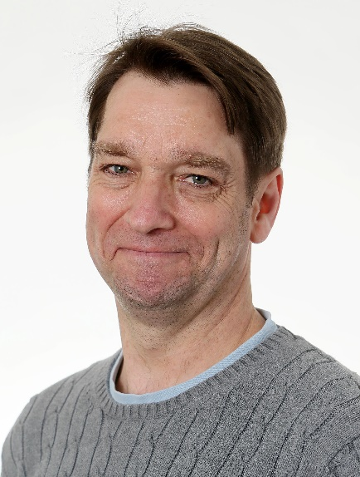
Slide 4 of 33
Cell Assembly-based Task Analysis (CAbTA)
Dan Diaper
DDD SYSTEMS
Chris Huyck
Middlesex University
Introduction
Cell Assemblies (CAs) are the basis of thought!
CAs are sets of neurons in your brain that are the neural basis of humans’ concepts, episodes, and processing.
So, if we want to analyse how we perform tasks, we can look at which CAs are used and how they interact.
Unfortunately, we can’t look at CAs directly, so we’re going to start with an educated guess.
We’ve come up with a methodology for CA based Task Analysis

Slide 5
Slide 5 of 33
Cell Assembly-based Task Analysis (CAbTA)
Dan Diaper
DDD SYSTEMS
Chris Huyck
Middlesex University
Cell Assemblies in the Brain
CAs do exist in brains.
For lots of evidence, see Huyck & Passmore (2013).
The human brain has about 10¹¹ neurons (Smith, 2010)
… the size range of ignited CAs has been suggested as 10³ to 10⁷ neurons,
although the upper estimates
probably refer to “super-CAs composed of many sub-CAs”.
N.B. The super/sub CA concept fits extremely well with TA’s use of levels.
At different times a neuron will be a member of different CAs.
Over to Dan

Slide 6








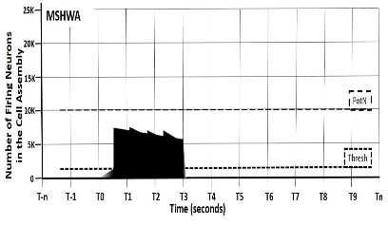

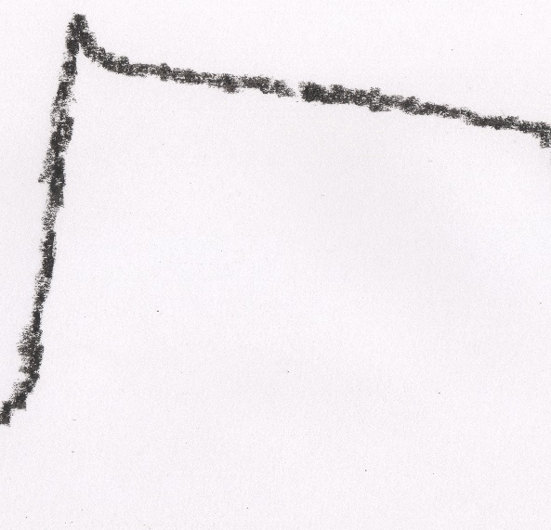
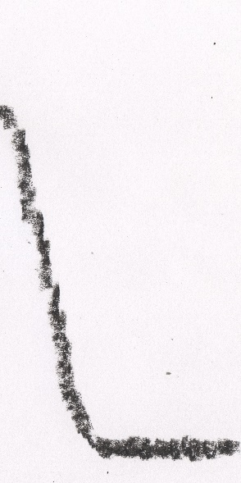




Slide 6 of 33
Cell Assembly-based Task Analysis (CAbTA)
Dan Diaper
DDD SYSTEMS
Chris Huyck
Middlesex University
The QPID Model
– pronounced “cupid”
A CA may be:
Q - Quiescent
P - Priming
I - Ignited
D - Decaying
Fatigue – some CAs can stay ignited for much longer than it takes for a neuron to fatigue and cease firing.
Number Neurons in the Cell Assembly
(10³ – 10⁷)
QPID – The Q, P and D aspects of CA lifecycles are (virtually) un-researched.
CA remains primed above the baseline (Q) level
Time
(seconds – minutes)
Decay (D) returns to the baseline (Q) level
Refractory period below the baseline (Q) level
D
☺
Q
P
I
So, there is lots of neural physiology still to discover.
Quiescent
Priming
Ignition
Decay

Slide 7



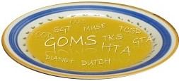

Slide 7 of 33
Cell Assembly-based Task Analysis (CAbTA)
Dan Diaper
DDD SYSTEMS
Chris Huyck
Middlesex University
Task Analysis – TA
There are 100s, or 1000s of TA “Methods”
& it’s a bit of an acronym soup.
TA is Engineering, NOT Science.
Practical, applied psychology is generally defended in TA as an engineering necessity, and …
Attend to the wise words
of David Kieras:
“… that some cognitive representations and processes similar to those identified during an analysis must occur.”
“a task analysis for system design must be rather more informal and primarily heuristic in ﬂavour compared to scientiﬁc research.”

Slide 8


Slide 8 of 33
Cell Assembly-based Task Analysis (CAbTA)
Dan Diaper
DDD SYSTEMS
Chris Huyck
Middlesex University
GOMS
Goals, Operations, Methods and Selection rules
One of the most widely used TA methods
But tends to be detailed (low level) and therefore expensive
Success e.g. good predictive adequacy
GOMSL Output – Example
Output – cognitive model
as program pseudocode
Method_for_goal: Edit Document Step.
Store First under <current_task_name>.
Step. Check_for_done.
Decide: If <current_task_name> is None,
Then Delete <current_task>; Delete <current_task_name>; Return_with_goal_accomplished.
Symbolic AI implementation
e.g. ACT R & EPIC
Step. Get_task_item_whose Name is <current_task_name>
and_store_under <current_task>.
Step. Accomplish_goal: Perform Unit_task.
Step. Store Next of <current_task> under <current_task_name>;
Goto Check_for_done.

Slide 9



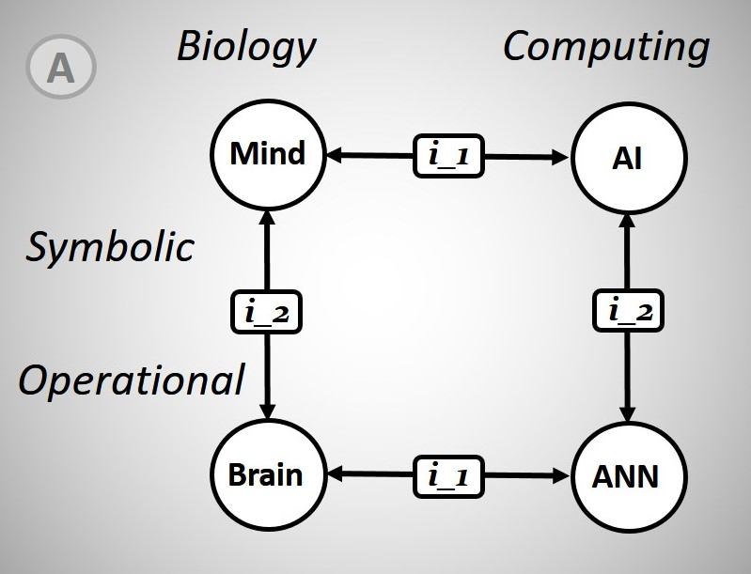
Slide 9 of 33
Cell Assembly-based Task Analysis (CAbTA)
Dan Diaper
DDD SYSTEMS
Chris Huyck
Middlesex University
The Square-of-Identity
2 types of Identity
GOMS
ACT R/EPIC
i_1
Similar translation
i_2
True ‘Identity Theory’ identity

Slide 10



Slide 10 of 33
Cell Assembly-based Task Analysis (CAbTA)
Dan Diaper
DDD SYSTEMS
Chris Huyck
Middlesex University
The Square-of-Identity
CAbTA
CAbTA
CABot

Slide 11


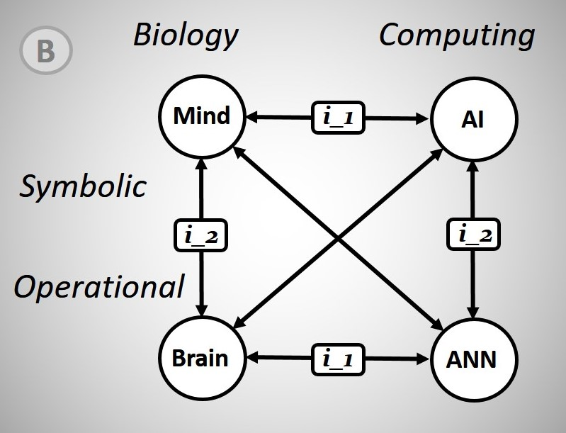
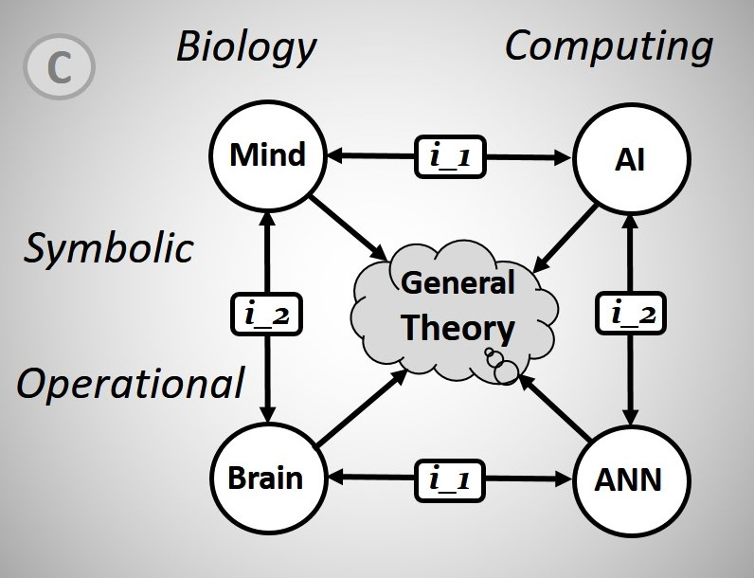
Slide 11 of 33
Cell Assembly-based Task Analysis (CAbTA)
Dan Diaper
DDD SYSTEMS
Chris Huyck
Middlesex University
The Square-of-Identity
?
CAbTA
CABot

Slide 12



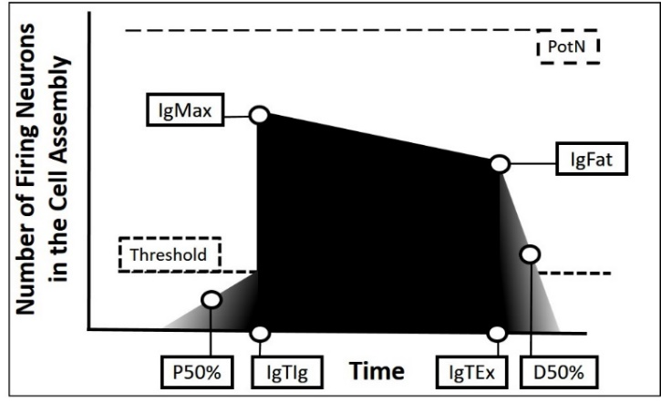
Slide 12 of 33
Cell Assembly-based Task Analysis (CAbTA)
Dan Diaper
DDD SYSTEMS
Chris Huyck
Middlesex University
CAbTA Models
The Simplified Cell Assembly Model (SCAM)
The four SCAM parameters associated with number of neurons are:
PotN – potential number of neurons that could have CA membership;
Thresh – threshold where there are sufficient neurons firing for CA ignition;
IgMax – maximum number of firing neurons at CA ignition;
IgFat – fatigue as number of firing neurons at CA ignition extinction.

Slide 13



Slide 13 of 33
Cell Assembly-based Task Analysis (CAbTA)
Dan Diaper
DDD SYSTEMS
Chris Huyck
Middlesex University
CAbTA Models
The Simplified Cell Assembly Model (SCAM)
The four SCAM parameters associated with time are:
P50% - time when a CA is primed to 50% of the required neurons firing to reach ignition threshold;
IgTIg – ignited CA’s time of ignition;
IgTEx – ignited CA’s time of extinction;
D50% – time when a CA decays to 50% of the neurons firing at CA extinction (IgFat).
No. | ID | PotN | Thresh | IgMax | IgFat | P50% | IgTIg | IgTEx | D50% | ID Acronym
01 | CKEC | 10 | 2 | 7 | 6 | -1.0 | 0.0 | 0.4 | 0.5 | COG Kitchen Entrance Check
02 | VKEG | 20 | 10 | 15 | 14 | -0.8 | 0.1 | 0.3 | 0.4 | VIS Kitchen Entrance General
03 | CMC | 5 | 1 | 2 | 1.5 | -1.0 | 0.4 | 2.5 | 4.0 | COG Make Coffee

Slide 14


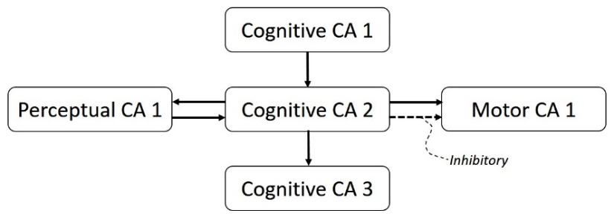
Slide 14 of 33
Cell Assembly-based Task Analysis (CAbTA)
Dan Diaper
DDD SYSTEMS
Chris Huyck
Middlesex University
CAbTA Models
The Cell Assembly Architecture Relationship (CAAR) Diagram
The CAAR Diagram is “architectural” in that it shows how CAs are related, over time.
The CAAR is not prescriptive, but there is a default architecture:
Chains of Cognitive CAs
which mediate between Perceptual and Motor CAs.

Slide 15






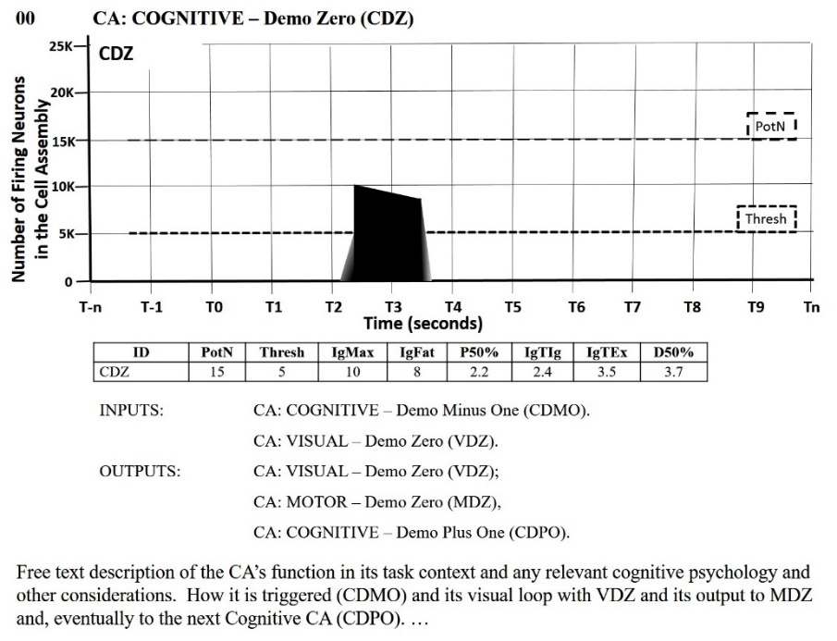
Slide 15 of 33
Cell Assembly-based Task Analysis (CAbTA)
Dan Diaper
DDD SYSTEMS
Chris Huyck
Middlesex University
CAbTA Models
The Main Analysis Document (MAD)
This is the CAbTA
METHOD
1 Assign a number and name
2 Start writing the “free” text
3 Consider the INPUTS
and OUTPUTS
4 Complete the SCAM table
5 Draw the SCAM Diagram
6 Draw the CAAR Diagram
ITERATE – a lot!

Slide 16




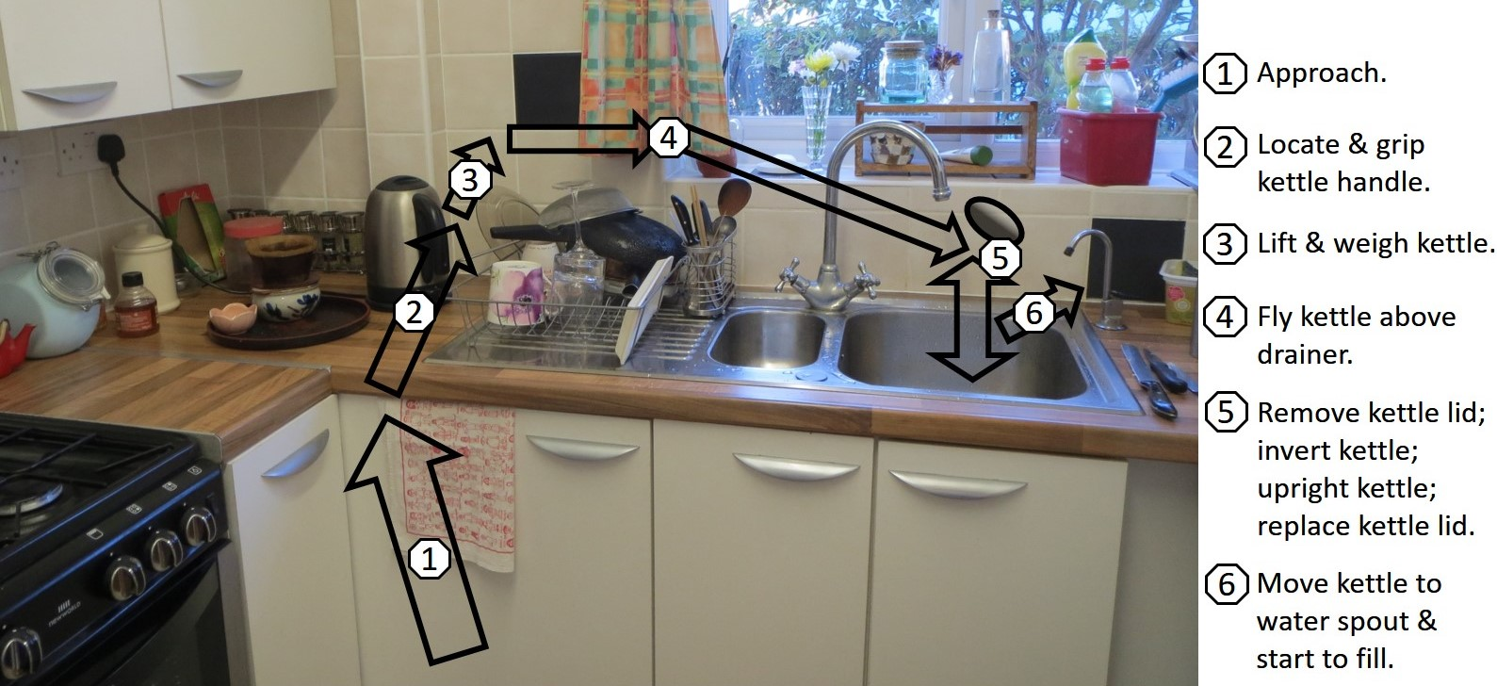
Slide 16 of 33
Cell Assembly-based Task Analysis (CAbTA)
Dan Diaper
DDD SYSTEMS
Chris Huyck
Middlesex University
The Analysed Task
Subtask – Preparing to fill the kettle
Activity List

Slide 17




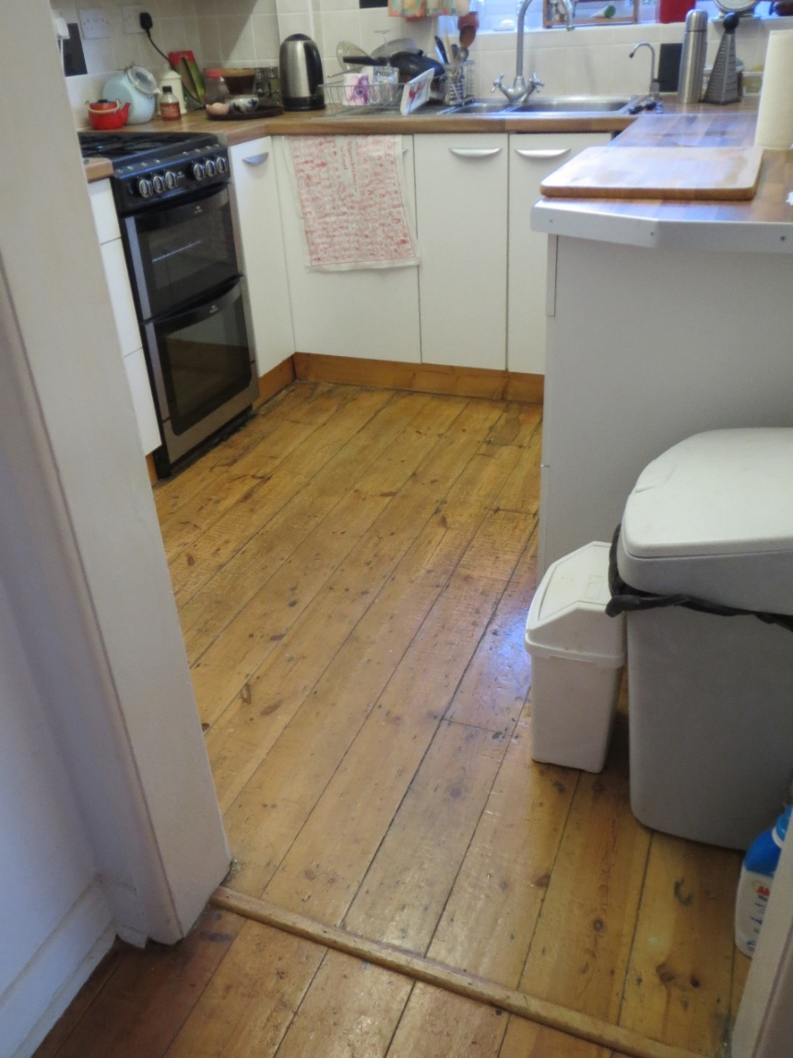
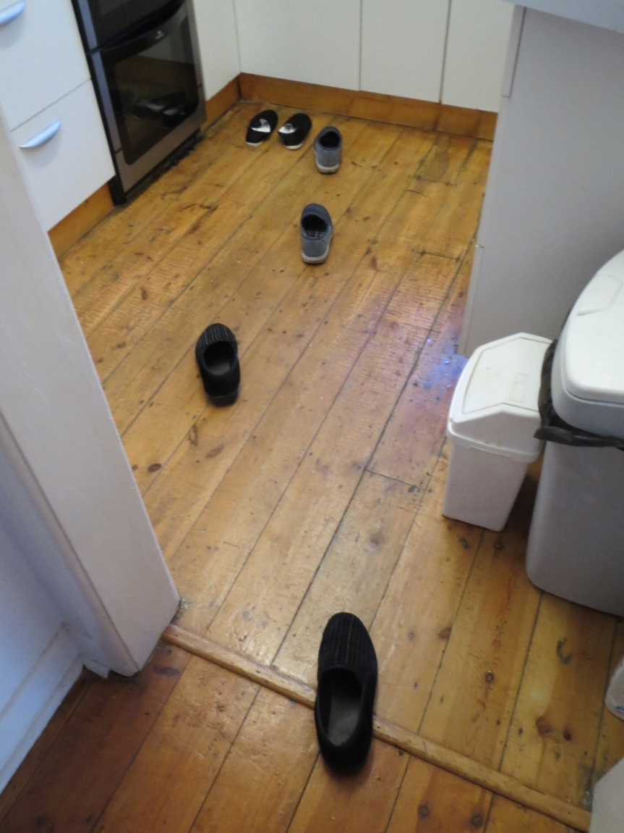
Slide 17 of 33
Cell Assembly-based Task Analysis (CAbTA)
Dan Diaper
DDD SYSTEMS
Chris Huyck
Middlesex University
The Analysed Task
(1) Approach
3
4
4
2
1
0

Slide 18



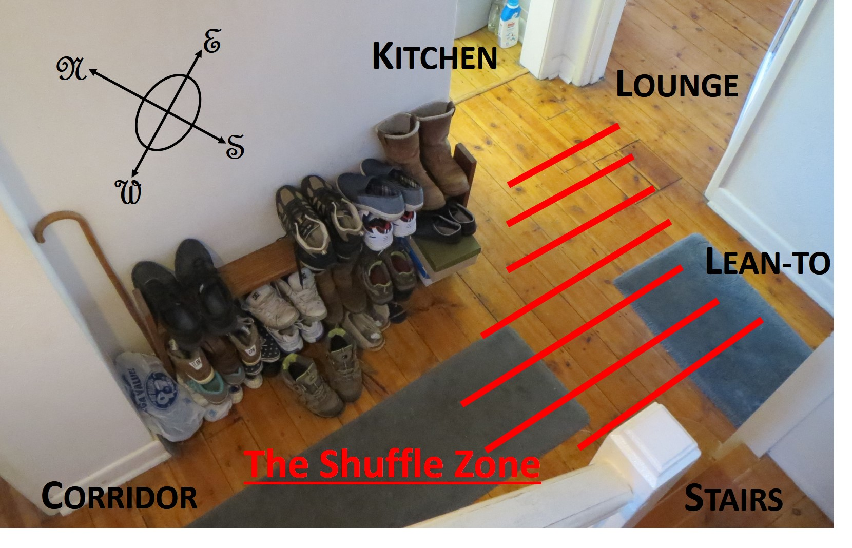
Slide 18 of 33
Cell Assembly-based Task Analysis (CAbTA)
Dan Diaper
DDD SYSTEMS
Chris Huyck
Middlesex University
The Analysed Task
(1) Approach

Slide 19



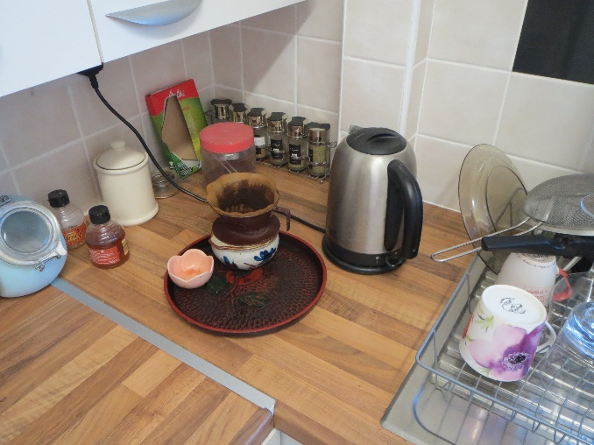
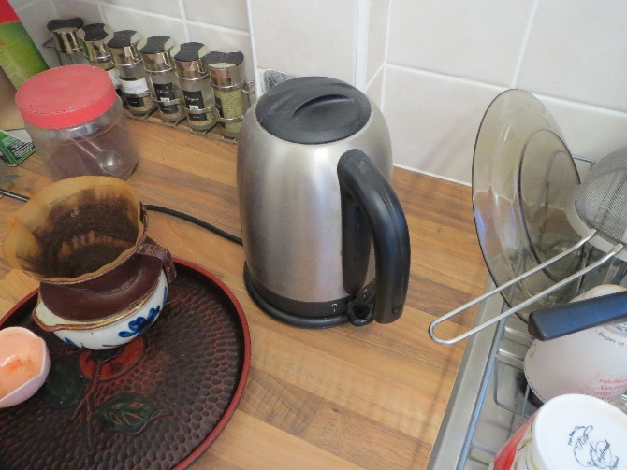
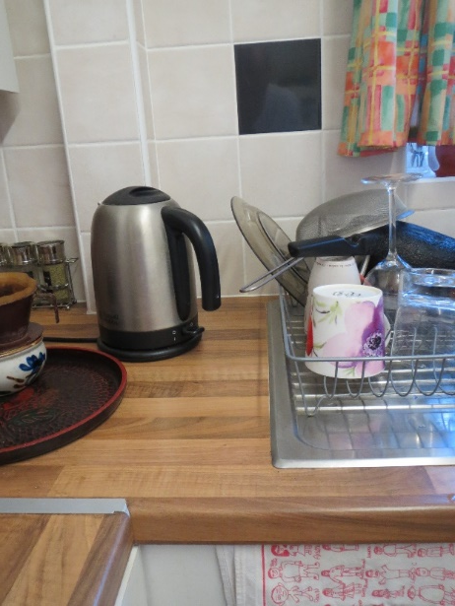
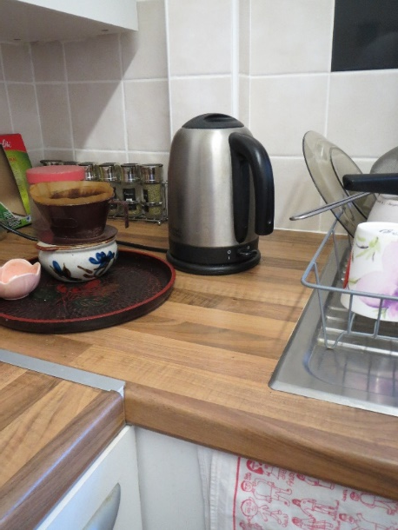
Slide 19 of 33
Cell Assembly-based Task Analysis (CAbTA)
Dan Diaper
DDD SYSTEMS
Chris Huyck
Middlesex University
The Analysed Task
(2) Locate & grip kettle handle
THE EYES’s “VIEW”
LEFT HAND “VIEW”
RIGHT HAND “VIEW”

Slide 20

Slide 20 of 33
Cell Assembly-based Task Analysis (CAbTA)
Dan Diaper
DDD SYSTEMS
Chris Huyck
Middlesex University
The Analysed Task
(3) Lift and weigh kettle
Activity List
weigh kettle – typical example in TA of inferring an invisible behaviour.
It must occur because water is heavy and what remains in the kettle will affect its lift and flight.

Slide 21


Slide 21 of 33
Cell Assembly-based Task Analysis (CAbTA)
Dan Diaper
DDD SYSTEMS
Chris Huyck
Middlesex University
The Analysed Task
(4) Fly kettle over drainer
Activity List
Flight path differs depending what is on the drainer.
Left hand tracks kettle top closing to intercept over the right hand sink.

Slide 22


Slide 22 of 33
Cell Assembly-based Task Analysis (CAbTA)
Dan Diaper
DDD SYSTEMS
Chris Huyck
Middlesex University
The Analysed Task
(5) Empty kettle
Activity List
Kettle lid removal swift, error free and highly coordinated.
Ditto lid replacement but slower.
Inversion fast, then a pause under visual feedback control for emptying, before kettle is righted.

Slide 23


Slide 23 of 33
Cell Assembly-based Task Analysis (CAbTA)
Dan Diaper
DDD SYSTEMS
Chris Huyck
Middlesex University
The Analysed Task
(6) Move kettle to water spout
Activity List
Kettle needs careful location of its spout to the filtered water spout without the two touching.
Left hand flicks tap switch up.
Left hand may rest on switch or move away …

Slide 24


Slide 24 of 33
Cell Assembly-based Task Analysis (CAbTA)
Dan Diaper
DDD SYSTEMS
Chris Huyck
Middlesex University
Results
The most important result is that a Cell Assembly-based Task Analysis is possible.
We have demonstrated this.

Slide 25


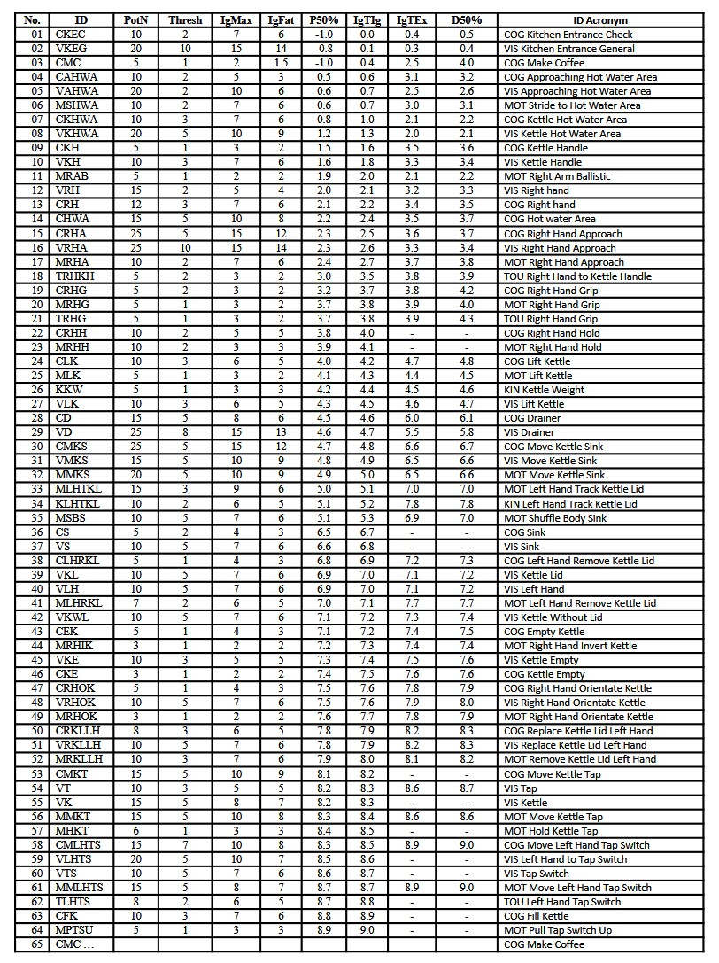
Slide 25 of 33
Cell Assembly-based Task Analysis (CAbTA)
Dan Diaper
DDD SYSTEMS
Chris Huyck
Middlesex University
Results
9 seconds of task
The SCAM Table
64 CAs identified
but 12 still ignited at analysis end
By CA type:
22/64 Cognitive (34%)
17/64 Motor (27%)
25/64 Perceptual (39%)
20/25 Visual (80%)
3/25 Touch (12%)
2/25 Kinaesthetic (8%)

Slide 26



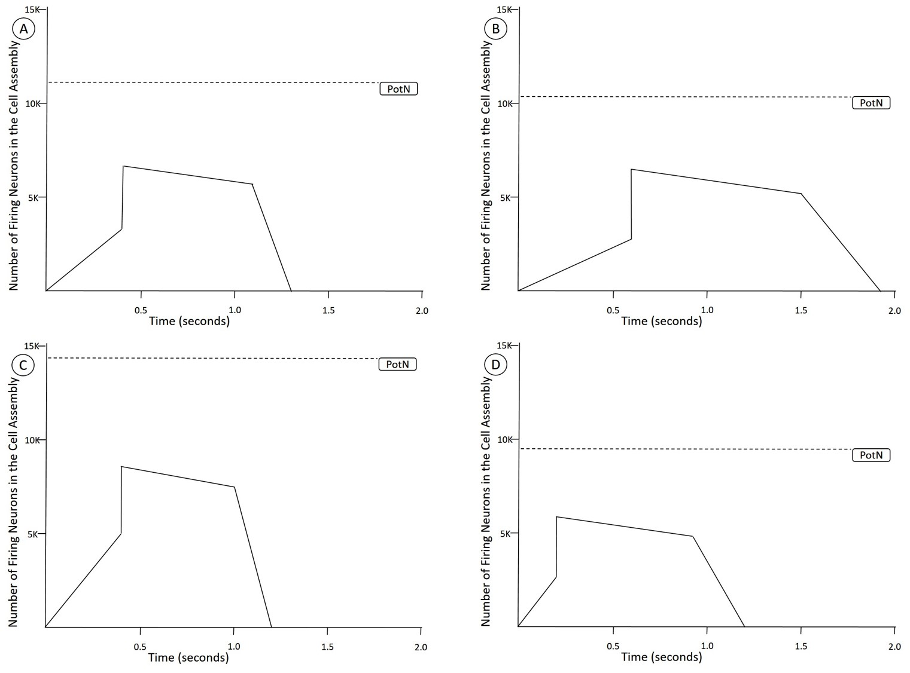
Slide 26 of 33
Cell Assembly-based Task Analysis (CAbTA)
Dan Diaper
DDD SYSTEMS
Chris Huyck
Middlesex University
Results
Averaged SCAM diagrams
Basic result is that we have applied our neural models appropriately and consistently
(A) All
(B) Cognitive
e.g.
Cognitive CAs persist the longest
Visual CAs are the largest
(C) Visual
(D) Motor.
Motor CAs are the quickest to ignition
Lots of other analysis that supports, or is neutral, to the basic result.

Slide 27




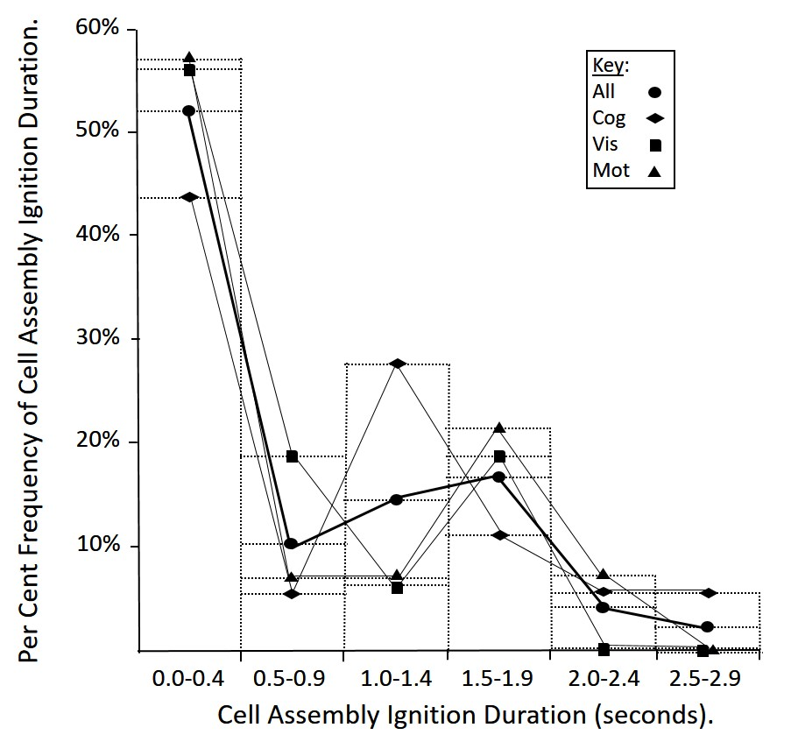
Slide 27 of 33
Cell Assembly-based Task Analysis (CAbTA)
Dan Diaper
DDD SYSTEMS
Chris Huyck
Middlesex University
Results
There is not enough data for even
non-parametric statistical testing
Per Cent Frequency of CA Ignition Duration
plotted against
CA Ignition Duration.
but there is a suggestion of
bi-modality.
Most CAs persist for less than half a second
The same data shown as both a histogram and a line graph.
About a fifth persist for one and a half to two seconds
An unexpected but understandable result.
Use half second bins.

Slide 28






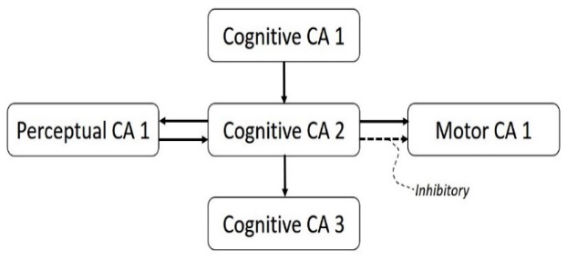
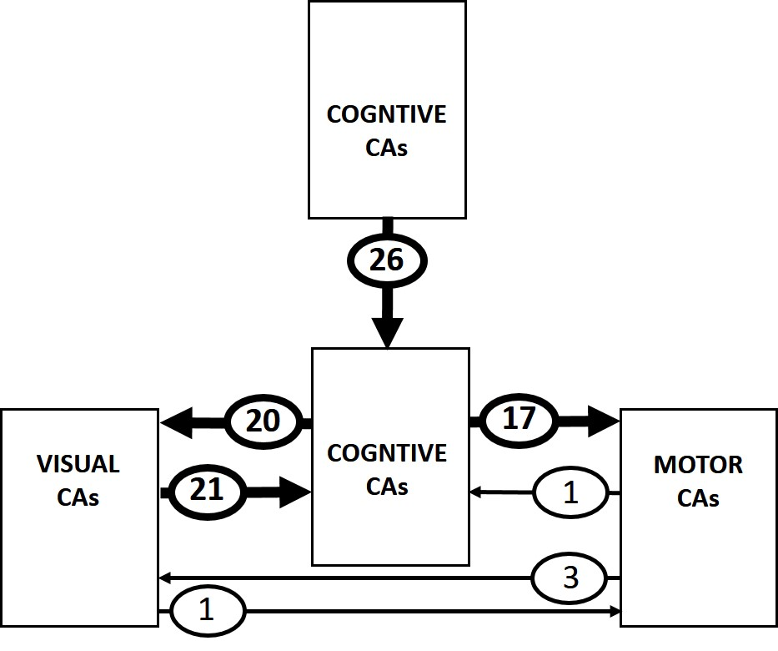
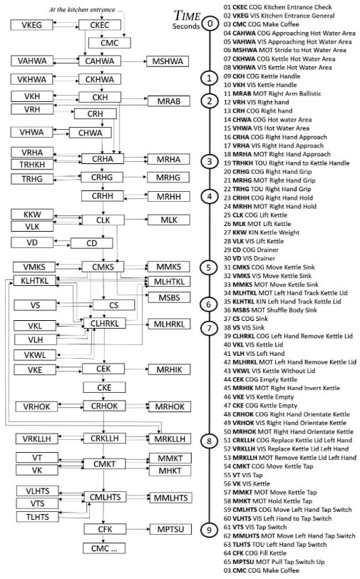
Slide 28 of 33
Cell Assembly-based Task Analysis (CAbTA)
Dan Diaper
DDD SYSTEMS
Chris Huyck
Middlesex University
Results
The important results are in bold.
The conclusion is that the default architecture is used.
The CAAR Diagram
Processing by chains of Cognitive CAs (26 instances).
There is a tight binding and cycling between Cognitive and Visual CAs (20 & 21 instances).
Motor CAs are initiated from Cognitive ones (17 instances).

Slide 29

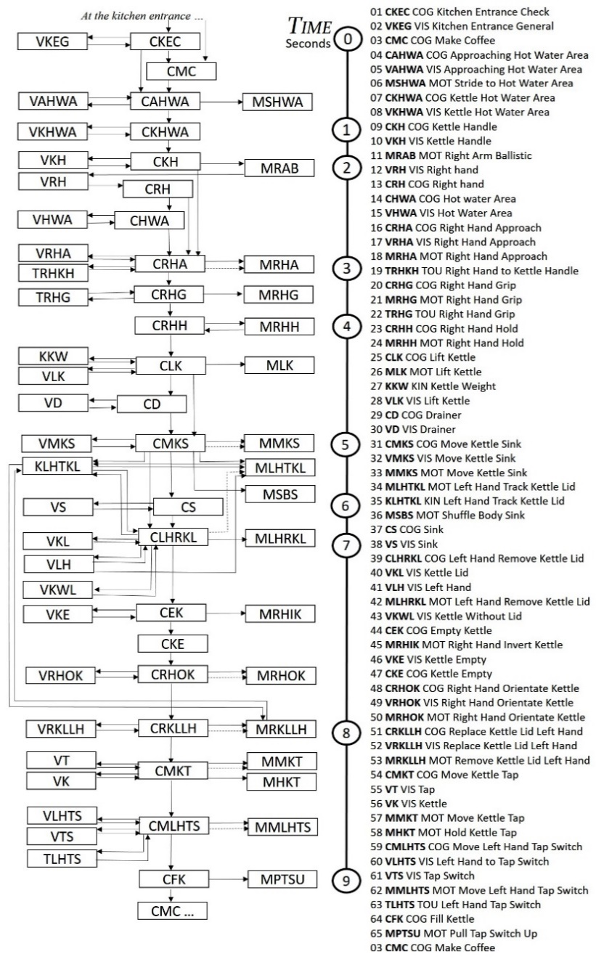
Slide 29 of 33
Cell Assembly-based Task Analysis (CAbTA)
Dan Diaper
DDD SYSTEMS
Chris Huyck
Middlesex University
Results
There is an animated version.
The CAAR Diagram
While too complicated to go through in detail in a seminar
it is perhaps possible to get a feel for how the processing operates by watching the animation.
The timing is approximately correct, slowed by a factor of about 13.
The Dynamic CAAR Diagram in mp4.

Slide 30
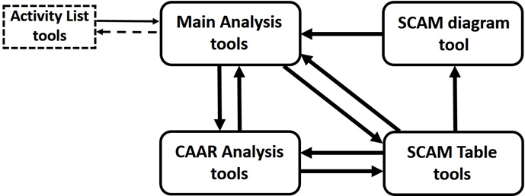
Slide 30 of 33
Cell Assembly-based Task Analysis (CAbTA)
Dan Diaper
DDD SYSTEMS
Chris Huyck
Middlesex University
Conclusions
Future Work: TA Tools
If we actually want to do a significant amount of CA base TA, we’re going to need some tools.
SCAM diagram, SCAM table, and CAAR analysis tools. These and more general tools should support TA and lead to improved TA.
Do more than wave our hands: implement a spiking CA model that supports parameters like the simplified cell assembly model, and connecting CAs.
Suite of CAs: CAs are compositional so many can be used in many tasks. High level tasks can be more firmly specified in lower level CAs. Reusability will lead to improved CAs & TA.

Slide 31
Slide 31 of 33
Cell Assembly-based Task Analysis (CAbTA)
Dan Diaper
DDD SYSTEMS
Chris Huyck
Middlesex University
Conclusions
Future Work: The Big Stuff
Suites of CAs and spiking SCAM models point to the big stuff. (CAs with shared neurons.)
We’ve made a lot of progress in symbolic neural programming, and the TA work would further that.
Completing the square of identity allows each field (CS, Psych, Neuro) to contribute to the other. Further exploration of each with respect to the others furthers this.
The difficult issue is learning. Neural systems learn all the time, and, with tasks (TA), people improve performance.

Slide 32
Slide 32 of 33
Cell Assembly-based Task Analysis (CAbTA)
Dan Diaper
DDD SYSTEMS
Chris Huyck
Middlesex University
Conclusions
You can do Task Analysis with Cell Assemblies
This cognitive engineering task involves psychology, neuroscience, and computer science
CAbTA fits in with a much larger research program involving cognition and AI
We’re looking for people to collaborate on these tasks
See The Task Analysis Cell Assembly Perspective
https://arxiv.org/ftp/arxiv/papers/1910/1910.10481.pdf

Slide 33
Slide 33 of 33
The End
The Dynamic CAAR Diagram in mp4.

