Slide 1
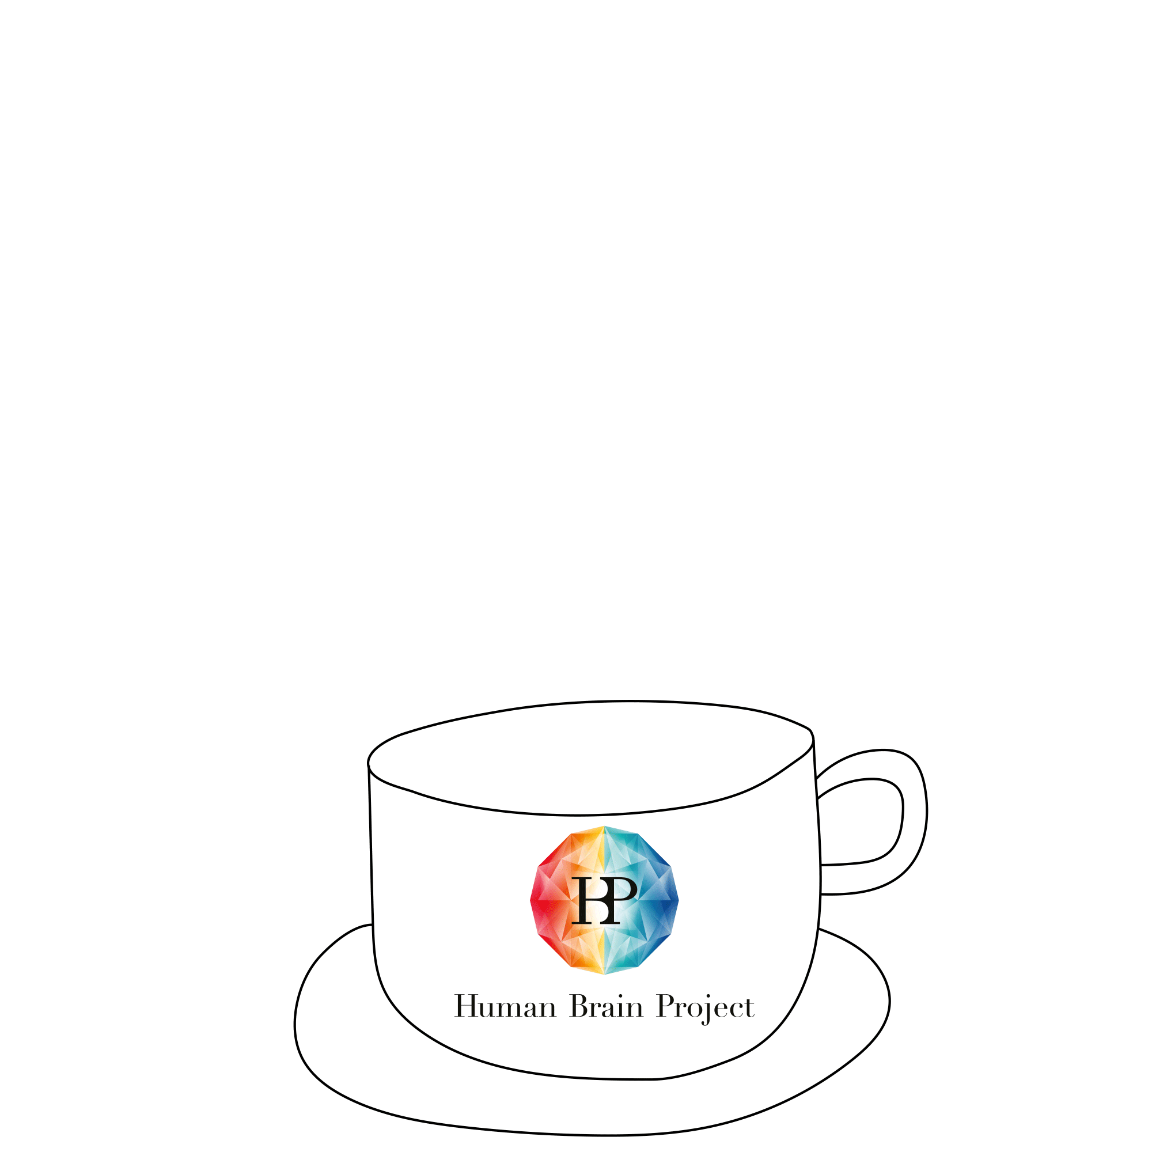
Hot coffee: associative memory with bump attractor cell assemblies of spiking neurons

Slide 2


Hot coffee: associative memory with bump attractor cell assemblies of spiking neurons
Christian R Huyck and Alberto A Vergani (alberto.vergani@univ-amu.fr)

Slide 3
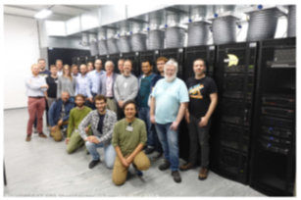



Hot coffee: associative memory with bump attractor cell assemblies of spiking neurons
Christian R Huyck and Alberto A Vergani (alberto.vergani@univ-amu.fr)
Postdoc 2019/early2020 on the Neuromorphic Embodied Agents that Learn (NEAL) https://www.cwa.mdx.ac.uk/NEAL/overview.html
Virtual agentAssembly Bot (CABot)
Associative Memory

Slide 4
Hot coffee: associative memory with bump attractor cell assemblies of spiking neurons
Christian R Huyck and Alberto A Vergani (alberto.vergani@univ-amu.fr)
Postdoc 2019/early2020 on the Neuromorphic Embodied Agents that Learn (NEAL) https://www.cwa.mdx.ac.uk/NEAL/overview.html
Virtual agent, i.e. a Cell Assembly Bot (CABot)
Associative memory and bump attractor network

Slide 5
Hot coffee: associative memory with bump attractor cell assemblies of spiking neurons
Christian R Huyck and Alberto A Vergani (alberto.vergani@univ-amu.fr)
Postdoc 2019/early2020 on the Neuromorphic Embodied Agents that Learn (NEAL) https://www.cwa.mdx.ac.uk/NEAL/overview.html
Virtual agent, i.e. a Cell Assembly Bot (CABot)
Associative memory and bump attractor network
Huyck, C.R. and Vergani, A.A., 2020. Hot coffee: associative memory with bump attractor cell assemblies of spiking neurons. Journal of Computational Neuroscience, 48(3), pp.299-316.

Slide 6
Hot coffee: associative memory with bump attractor cell assemblies of spiking neurons
Christian R Huyck and Alberto A Vergani (alberto.vergani@univ-amu.fr)
Postdoc 2019/early2020 on the Neuromorphic Embodied Agents that Learn (NEAL) https://www.cwa.mdx.ac.uk/NEAL/overview.html
Virtual agent, i.e. a Cell Assembly Bot (CABot)
Associative memory and bump attractor network
Huyck, C.R. and Vergani, A.A., 2020. Hot coffee: associative memory with bump attractor cell assemblies of spiking neurons. Journal of Computational Neuroscience, 48(3), pp.299-316.
Concepts representation in the brain

Slide 7
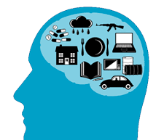
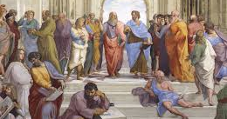
Concepts and brain
- how the brain represents physical concepts, i.e., continuously value concepts?
  Pressure, force, temperature, etc
- how the brain represents semantic or categorial concepts, i.e., discrete-like concepts?
  Dog, car, house, sun, etc
- one practical example is about set of beverages, judgments and physical quantities

Slide 8

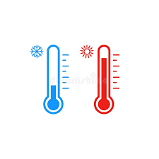

Concepts and brain
- operative examples of both discrete-like and continuously-like concepts are about sets of beverages, judgments and physical quantities
  How temperature grades are represented in the brain?
  How are represented and linked concepts like hot and coffee or cold and coke?
  How the same hot concept manage the hot-coffee meaning and the hot-coke meaning?

Slide 9
Concepts and brain
- operative examples of both discrete-like and continuously-like concepts are about sets of beverages, judgments and physical quantities
  How temperature grades are represented in the brain?
  How are represented and linked concepts like hot and coffee or cold and coke?
  How the same hot concept manage the hot-coffee meaning and the hot-coke meaning?

Slide 10
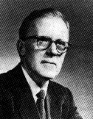
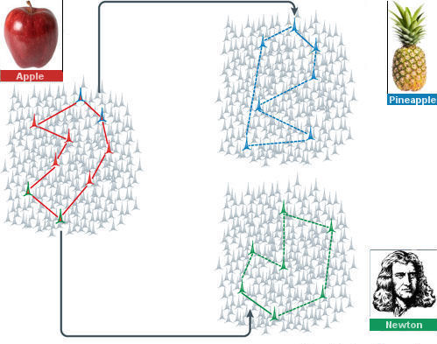
Concepts Representations
Cell Assembly (CA)
10

Slide 11
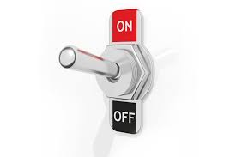
Concepts Representations
Binary CA
(Semantic/discrete Concepts)
Cell Assembly (CA)
11

Slide 12
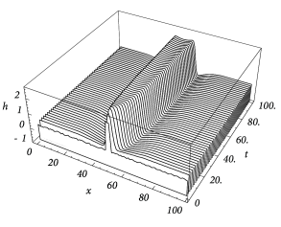
Concepts Representations
Binary CA
(Semantic/discrete Concepts)
Cell Assembly (CA)
Bump CA
(Continuously-Value concepts)
Gerstner et al 2014
Gerstner et al 2014
12

Slide 13
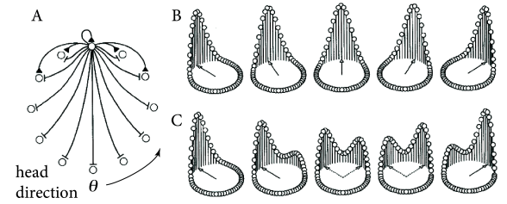
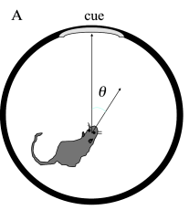

Concepts Representations
Binary CA
(Semantic/discrete Concepts)
Cell Assembly (CA)
Bump CA
(Continuously-Value concepts)
Zugaro et al 2013, in Gestner 2014
Gerstner et al 2014
Gerstner et al 2014
13

Slide 14
Concepts Representations
Binary CA
(Semantic/discrete Concepts)
Cell Assembly (CA)
Let’s go more in the adopted model!
Bump CA
(Continuously-Value concepts)
Zugaro et al 2013, in Gestner 2014
Gerstner et al 2014
Gerstner et al 2014
14

Slide 15
Cell Assemblies set and Topology
Cell Assemblies (CAs)
simple CA
COKE
COFFEE
WARM
COLD
HOT
TEMPERATURE
e.g.,85°
15

Slide 16
Cell Assemblies set and Topology
Cell Assemblies (CAs)
simple CA
COKE
COFFEE
WARM
COLD
HOT
TEMPERATURE
e.g.,85°
compound CA
(hot-coffee-85°C)
16

Slide 17

Cell Assemblies set and Topology
C1
C2
C3
Triadic associations memory
Cell Assemblies (CAs)
simple CA
COKE
COFFEE
WARM
COLD
HOT
TEMPERATURE
e.g.,85°
compound CA
(hot-coffee-85°C)
17

Slide 18


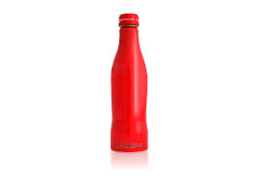
Cell Assemblies set and Topology
C1
C2
C3
Input Temperature
Triadic associations memory
Cell Assemblies (CAs)
simple CA
Coffee Temperature
Coke Temperature
COKE
Inhibition
COFFEE
Coke
Coffee
WARM
COLD
HOT
Cold
Warm
Hot
TEMPERATURE
0-24 °C
25-69 °C
70-99 °C
e.g.,85°
0-9 °C
10-24 °C
25-99 °C
compound CA
(hot-coffee-85°C)

Slide 19
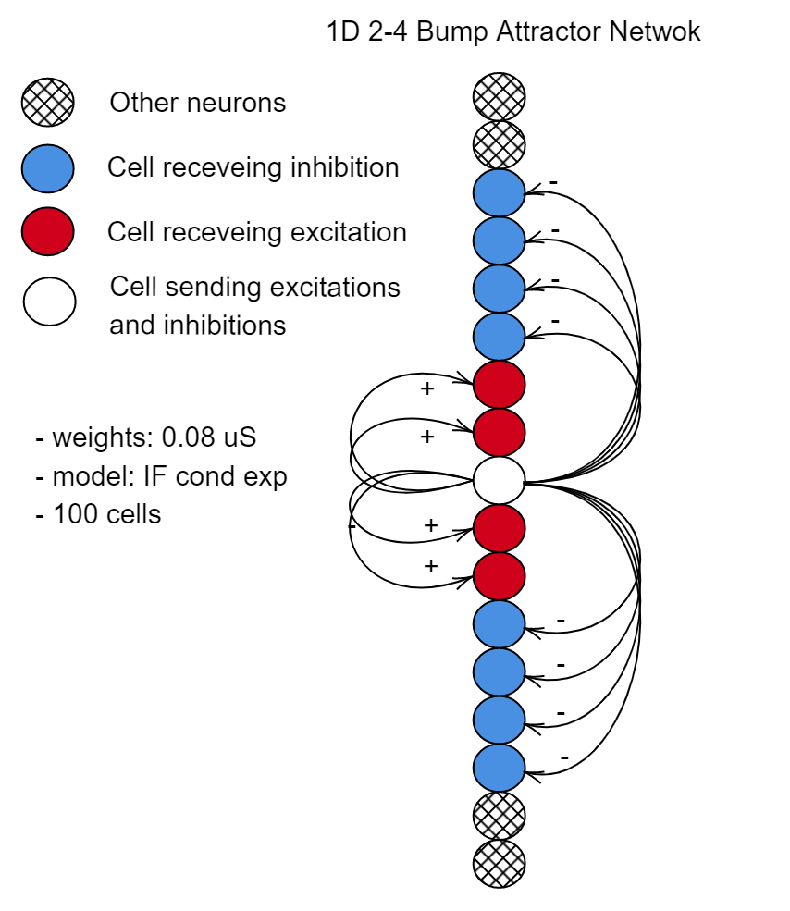


Cell Assemblies set and Topology
Input Temperature
Coffee Temperature
Coke Temperature
Inhibition
Coke
Coffee
PyNN
Cold
Warm
Hot
0-24 °C
25-69 °C
70-99 °C
0-9 °C
10-24 °C
25-99 °C

Slide 20
Cell Assemblies set and Topology
Input Temperature
MOVE FROM STRUCTURE TO FUNCTION
Coffee Temperature
Coke Temperature
Inhibition
Coke
Coffee
PyNN
Cold
Warm
Hot
0-24 °C
25-69 °C
70-99 °C
0-9 °C
10-24 °C
25-99 °C

Slide 21
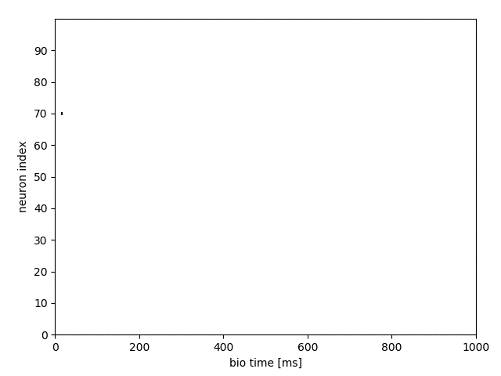
Splitting dynamics…, e.g. hot-coffee*
Hot
70-99
25-69
Warm
Cold
0-24
PyNN

Slide 22
Splitting dynamics…, e.g. hot-coffee*
Hot
70-99
25-69
Warm
Cold
0-24
PyNN
From a cognitive point of view, the concept of hot coffee temperature is functionally fragmented in this model

Slide 23


Splitting dynamics…, e.g. hot-coffee*
TOPOLOGY MODIFICATION
Overcame subnet
Merge
subnet
Hot
70-99
25-69
Warm
Input Temperature
Cold
0-24
Coffee Temperature
Coke Temperature
Inhibition
Coke
Coffee
From a cognitive point of view, the concept of hot coffee temperature is functionally fragmented in this model
Cold
Warm
Hot

Slide 24
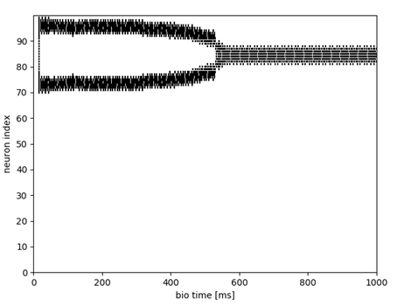
Splitting dynamics…, e.g. hot-coffee*
TOPOLOGY MODIFICATION
Overcame subnet
Merge
subnet
Hot
70-99
25-69
Warm
Input Temperature
Cold
0-24
Coffee Temperature
Coke Temperature
Inhibition
Coke
Coffee
Converging time. It’s not biological et all, BUT by using Hebbian learning for triadic associations we reach <300 ms
-> see the Supplementary section D.3 Associative memory with learning
Cold
Warm
Hot

Slide 25
Splitting dynamics…, e.g. hot-coffee*
TOPOLOGY MODIFICATION
Overcame subnet
Merge
subnet
Hot
70-99
COFFEE
25-69
Warm
WARM
Input Temperature
Cold
0-24
e.g.,50°
Coffee Temperature
Coke Temperature
Inhibition
Coke
Coffee
Converging time. It’s not biological et all, BUT by using Hebbian learning for triadic associations we reach <300 ms
-> see the Supplementary section D.3 Associative memory with learning
Cold
Warm
Hot

Slide 26
Splitting dynamics…, e.g. hot-coffee*
TOPOLOGY MODIFICATION
Overcame subnet
Merge
subnet
Hot
70-99
COFFEE
25-69
These coffee results are exemplificative.
  Complete combinatorial concepts activations
  (warm-coffee, cold-coke, etc) are in Fig8 in the paper.
  See Supplementary material D.3.
Warm
WARM
Input Temperature
Cold
0-24
e.g.,50°
Coffee Temperature
Coke Temperature
Inhibition
Coke
Coffee
Converging time. It’s not biological et all, BUT by using Hebbian learning for triadic associations we reach <300 ms
-> see the Supplementary section D.3 Associative memory with learning
Cold
Warm
Hot

Slide 27
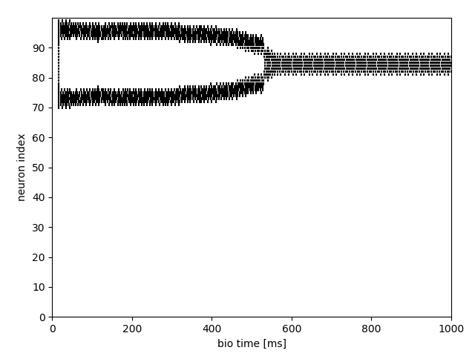
Recap
persistently and act a STM
Results1. 1D bump attractor with 2/4 Exc-Inh connections shown splitting functional dynamics
Results2. Extra subnetworks: Merge and Overcame subnet in the beverage temperature net.
Results3. Biological converging time by using Hebbian learning for the associations
Input Temperature
Cell Assemblies (CAs)
COKE
Coke Temperature
COFFEE
Coke
Coffee Temperature
Coffee
WARM
Inhibition
COLD
HOT
TEMPERATURE
Cold
Warm
Hot
e.g.,85°

Slide 28
Recap
Associative memory of binary and bump attractors cell assemblies store discrete-like concepts (coffee, coke, cold, etc) and continuously value concepts (temperature). They fire persistently and act a STM.
Results1. 1D bump attractor with 2/4 Exc-Inh connections shown splitting functional dynamics
Results2. Extra subnetworks: Merge and Overcame subnet in the beverage temperature net.
Results3. Biological converging time by using Hebbian learning for the associations
Input Temperature
Cell Assemblies (CAs)
COKE
Coke Temperature
COFFEE
Coke
Coffee Temperature
Coffee
WARM
Inhibition
COLD
HOT
TEMPERATURE
Cold
Warm
Hot
e.g.,85°

Slide 29
Recap
Associative memory of binary and bump attractors cell assemblies store discrete-like concepts (coffee, coke, cold, etc) and continuously value concepts (temperature). They fire persistently and act a STM
Results1: found splitting functional dynamics in 1D bump attractor with 2/4 Exc-Inh connections
Results2: convergence via extra subnetworks with Merge and Overcame subnets on the bump net.
Results3: convergence in biological time (decision < 300ms) with Hebbian learning for the associations
Results2: extra subnetworks. Merge and Overcame subnet in the beverage temperature net.
Results3: biological time. Hebbian learning for the associations
Input Temperature
Cell Assemblies (CAs)
COKE
Coke Temperature
COFFEE
Coke
Coffee Temperature
Coffee
WARM
Inhibition
COLD
HOT
TEMPERATURE
Cold
Warm
Hot
e.g.,85°

Slide 30
Recap
Associative memory of binary and bump attractors cell assemblies store discrete-like concepts (coffee, coke, cold, etc) and continuously value concepts (temperature). They fire persistently and act a STM.
Results1: found splitting functional dynamics in 1D bump attractor with 2/4 Exc-Inh connections
Results2: convergence via extra subnetworks with Merge and Overcame subnets on the bump net.
Results3: convergence in biological time (decision < 300ms) with Hebbian learning for the associations
Results3: biological time. Hebbian learning for the associations
Input Temperature
Cell Assemblies (CAs)
COKE
Coke Temperature
COFFEE
Coke
Coffee Temperature
Coffee
WARM
Inhibition
COLD
HOT
TEMPERATURE
Cold
Warm
Hot
e.g.,85°

Slide 31
Recap
Associative memory of binary and bump attractors cell assemblies store discrete-like concepts (coffee, coke, cold, etc) and continuously value concepts (temperature). They fire persistently and act a STM.
Results1: found splitting functional dynamics in 1D bump attractor with 2/4 Exc-Inh connections
Results2: convergence via extra subnetworks with Merge and Overcame subnets on the bump net.
Results3: convergence in biological time (decision < 300ms) with Hebbian learning for the associations
Input Temperature
Cell Assemblies (CAs)
COKE
Coke Temperature
COFFEE
Coke
Coffee Temperature
Coffee
WARM
Inhibition
COLD
HOT
TEMPERATURE
Cold
Warm
Hot
e.g.,85°

Slide 32
Link and References
Huyck, C.R. and Vergani, A.A., 2020. Hot coffee: associative memory with bump attractor cell assemblies of spiking neurons. Journal of Computational Neuroscience, 48(3), pp.299-316.
Gewaltig, M.O. and Diesmann, M., 2007. Nest (neural simulation tool). Scholarpedia, 2(4), p.1430.
Davison, A.P., Brüderle, D., Eppler, J.M., Kremkow, J., Muller, E., Pecevski, D., Perrinet, L. and Yger, P., 2009. PyNN: a common interface for neuronal network simulators. Frontiers in neuroinformatics, 2, p.11.
Code for running simulations: https://www.cwa.mdx.ac.uk/NEAL/wta.html

Slide 33
Thanks!

Slide 34
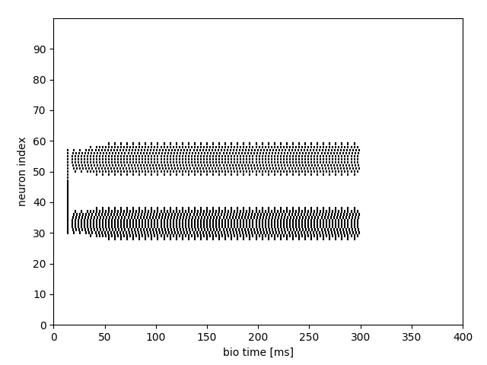
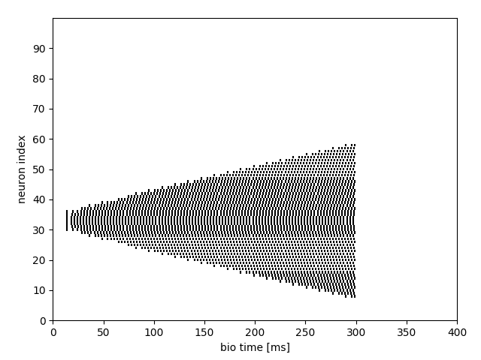
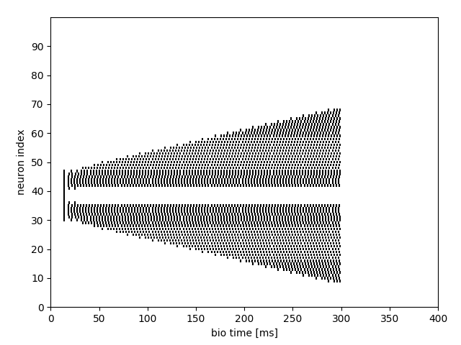
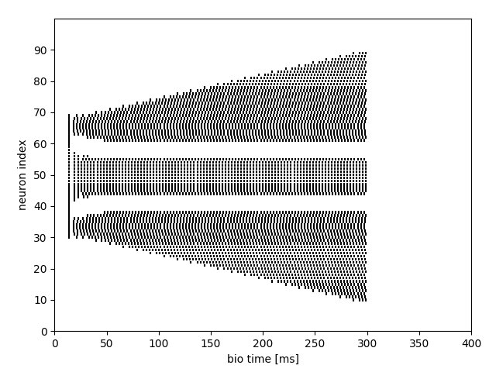
Multi-attractors
We found several attractors dynamics, NOT only 2D streams functional splitting
The weights adopted are ±0.08, but they are the results of an extended combinatorial exploration.
See Tab 3 and Tab 4 in supplementary material. Different weights combinations lead to different functional dynamics (splitting, diverging, diverging and splitting, etc).

Slide 35
Multi-attractors
We found several attractors dynamics, NOT only 2D streams functional splitting
The weights adopted are ±0.08, but they are the results of an extended combinatorial exploration.
See Tab 3 and Tab 4 in supplementary material. Different weights combinations lead to different functional dynamics (splitting, diverging, diverging and splitting, etc).
Vergani, A.A. and Huyck, C.R., 2020. Critical Limits in a Bump Attractor Network of Spiking Neurons. arXiv preprint arXiv:2003.13365.
Neuromorphic implementations on SpiNNaker.
https://arxiv.org/abs/2003.13365

